Slide 1
UNDERSTANDING MOLECULAR GEOMETRIES
PREDICTED BY VSEPR
H
H
C
H
H
FROM THE PERSPECTIVE OF
HYBRIDIZATION OF ATOMIC ORBITALS

Slide 3
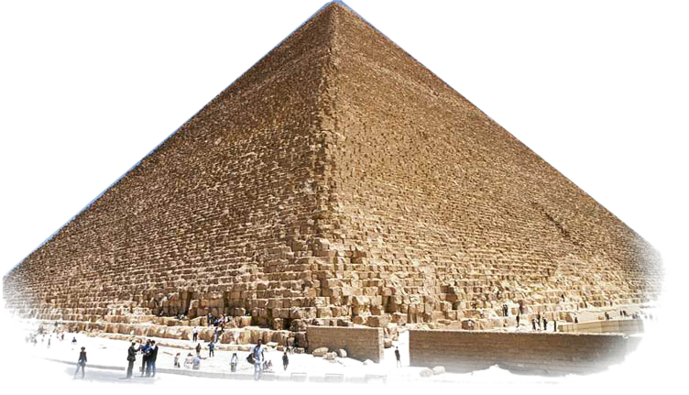
What are the building blocks?
Subatomic particles
Protons
Electrons
s orbital
p orbital
d orbital
Hybrids
Atoms
Carbon
Hydrogen
Oxygen
Nitrogen
Phosphorus
Chlorine
Molecules
Methane
Formaldehyde
Hydrogen cyanide
Phosphorus pentachloride

Slide 4
Electron, Both wave and particle

Slide 5
Electron: Both wave and particle

Slide 6
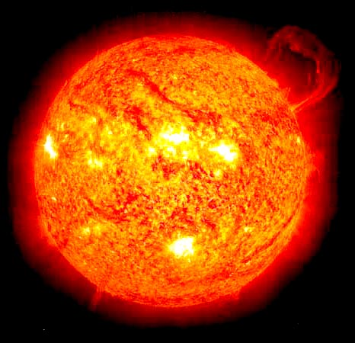
FORCE & ENERGY
The forces at work are:
Electromagnetic:
Repulsion of like charges: proton-proton and electron-electron Attraction of unlike charges: proton-electron.
Magnetic:
Electron spin introduces magnetic forces. Electrons with opposite spins produce opposite magnetic poles. Opposite magnetic poles attract. Opposite spin is required for electrons to occupy the same orbital.
N
S
S
N

Slide 7
FORCE & ENERGY
The Energies involved:
Electron (orbital) Potential Energy:
3d
4p
ENERGY LEVEL
4s
3p
3s
2p
2s
1s

Slide 8
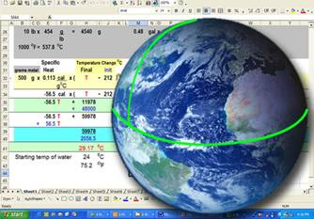
MATHEMATICS
Bond Angles
109.5º
120º
90º
180º

Slide 9
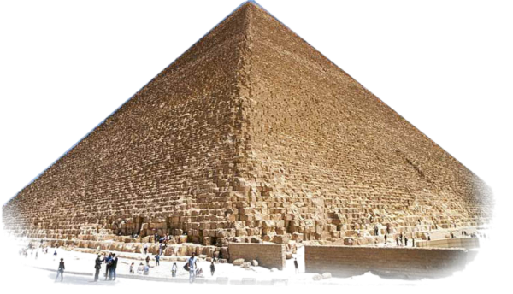
s, p, & d Orbitals
p Orbitals
P_{x}
P_{x}
P_{z}
P_{z}
P_{y}
P_{y}

Slide 10
Methane building blocks
H
C
H
H
H
C
H
H
C
H
H
H
VSEPR

Slide 11
Methane building blocks
H
C
H
H
H
C
H
H
C
H
H
H
VSEPR

Slide 12
1s
2s
2p_{x}
2p_{y}
2p_{z}
sp³ sp³ sp³ sp³
y
Hybridize
Promote
3
sp
x
109.5º
z
Methane: Carbon

Slide 13
Formaldehyde
CH₂O
H
C
O
120º
H
C
O
H
C
O
H
H
VSEPR

Slide 14
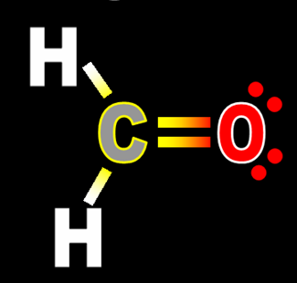
1s
2s
2p_{x}
2p_{y}
2p_{z}
sp² sp² sp²
Promoted
Hybridized
120º
2
sp
Trigonal Planar
120º
2s + 2p_{x} + 2p_{z}
Formaldehyde: Carbon

Slide 15
1s
2s
2p_{x}
2p_{y}
2p_{z}
sp² sp² sp²
Hybridized
Lone Pairs
120º
2
sp
Trigonal Planar
120º
2s + 2p_{x} + 2p_{z}
Formaldehyde: Oxygen

Slide 16
Formaldehyde
π bond
Sigma bond

Slide 17
Hydrogen Cyanide
HCN
H
C
N
H
C
N
H
C
N

Slide 18
1s
2s
2p_{x}
2p_{y}
2p_{z}
sp sp
Promoted
Hybridized
H
C
N
sp
Linear
2s + 2p_{x}
Hydrogen Cyanide: Carbon

Slide 19
1s
2s
2p_{x}
2p_{y}
2p_{z}
sp sp
Hybridized
H
C
N
sp
Linear
2s + 2p_{x}
Hydrogen Cyanide: Nitrogen

Slide 20
Hydrogen Cyanide
HCN
π bond
C
N
Sigma bond
π bond
H
C
N

Slide 21
Phosphorus Pentachloride
PCl₅
P
Cl
Cl
Cl
Cl
Cl
Cl
Cl
P
P
Cl
Cl
Cl
Cl
VSEPR

Slide 22
sp³d sp³d sp³d sp³d sp³d
Neon
2
3s
3p_{x}
3p_{y}
3p_{z}
d_{xz} d_{yz} d_{xy} d_{x}2_{-y}2 d_{z}2
90º
Hybridized
Promoted
3
120º
sp d
Trigonal Bipyrimidal
120º
Phosphorus Pentachloride: Phosphorus

Slide 23
Cl
Cl
P
Cl
Cl
Cl

Slide 24
UNDERSTANDING MOLECULAR GEOMETRIES
PREDICTED BY VSEPR
H
H
C
H
H
FROM THE PERSPECTIVE OF
HYBRIDIZATION OF ATOMIC ORBITALS

