Slide 1
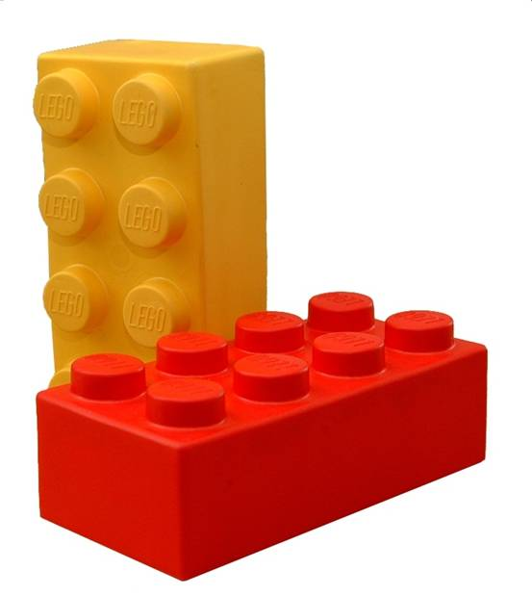
It’s all about building blocks…
CHEMISTRY
…and how they bond together.

Slide 2
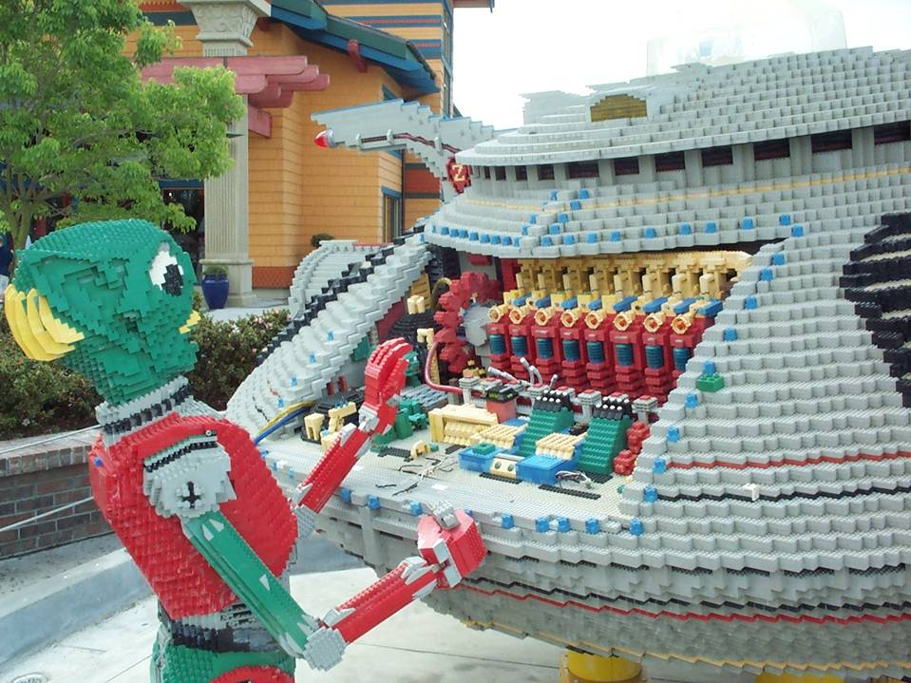

Slide 3
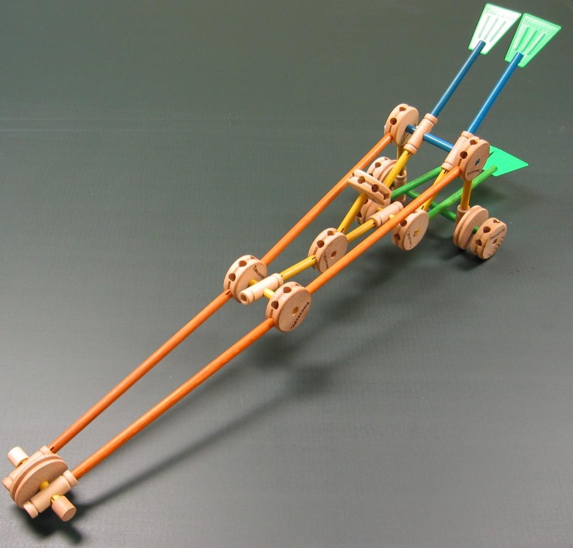
What makes good building blocks?
The ever popular “Tinkertoys” gives us some clues.
Blocks must allow for a way to connect to one part to another.
Tinkertoys had circular blocks with holes in them, Sticks acted as connectors.
With sticks of different lengths and a few kinds of blocks with holes in them, a wide variety of things could be assembled.

Slide 4
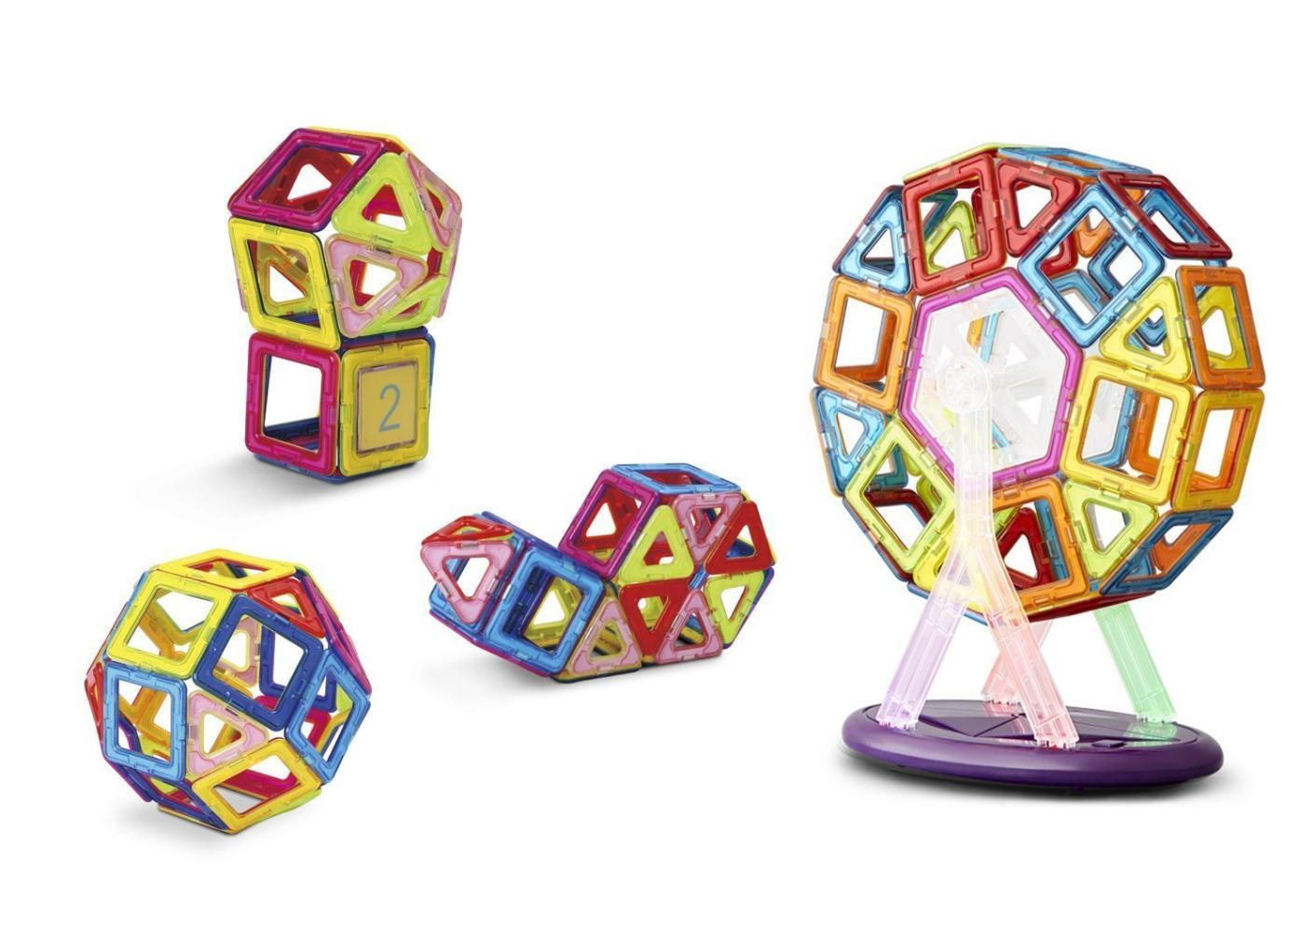
Building blocks that are based on magnets. These allow more flexible angles than Legos or Tinkertoys.

Slide 5
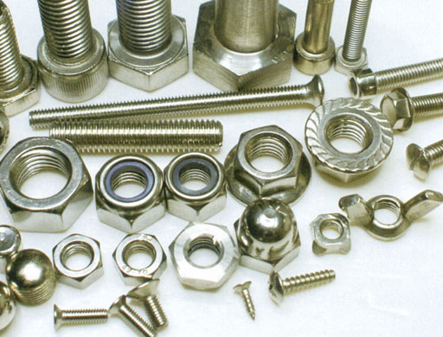
Bolts and nuts are connectors that require finding the matching size and thread. Electrons as connectors don’t have the restriction.

Slide 6
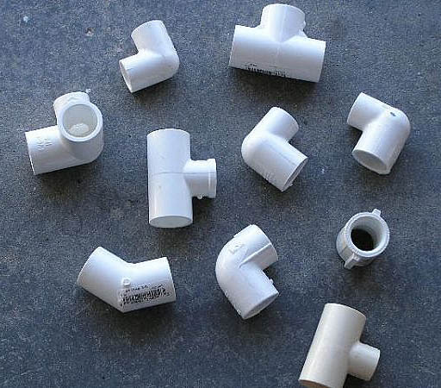
PVC pipe connectors also require choosing a certain size, plus the choices of angles are very limited. Electrons are much more flexible.

Slide 7
1. Electric charge is of two types:
Positive and negative
2. Unlike charges attract and like charges repel.
_
+
+
+

Slide 8
Proton Neutron Electron

Slide 9
Electron: Both wave and particle

Slide 10
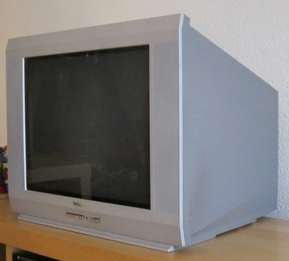
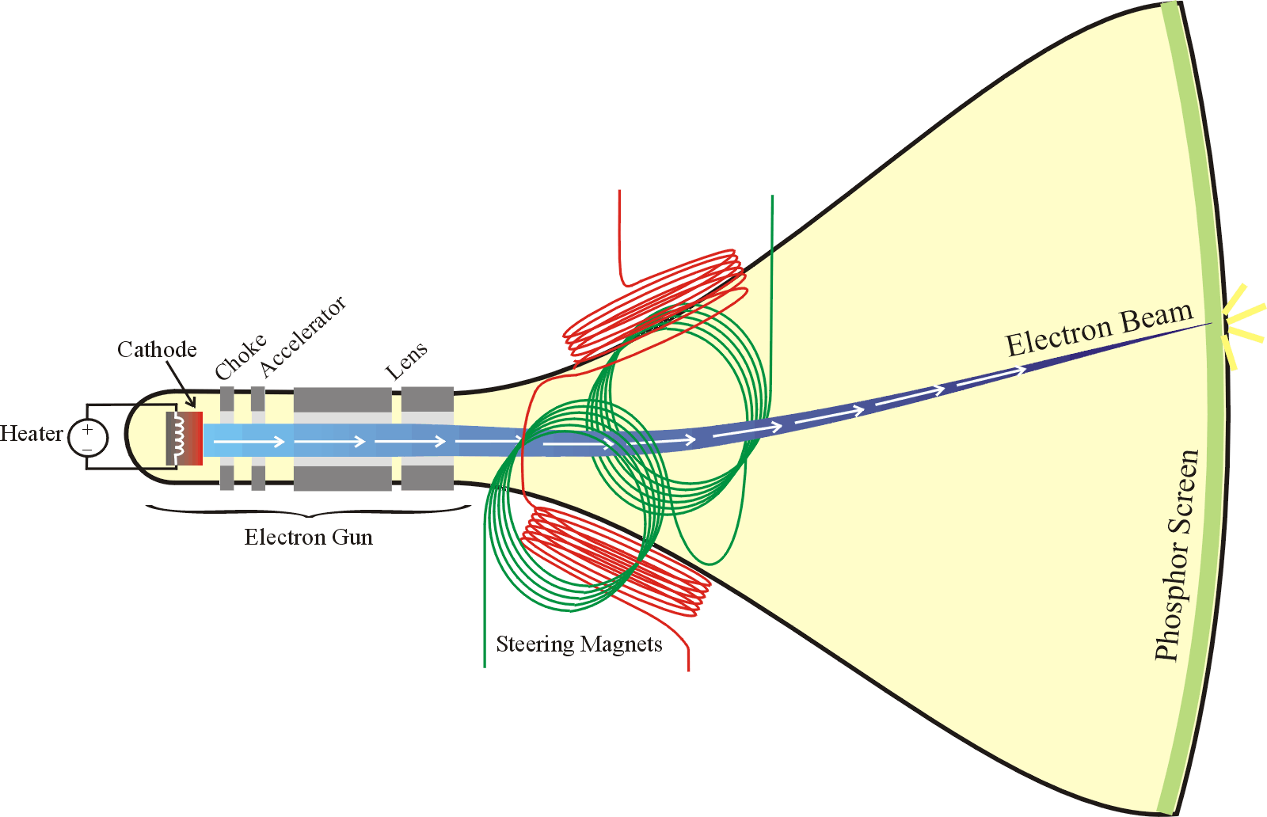

Slide 11
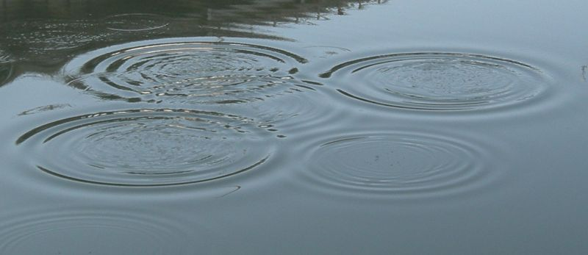
Electrons sometimes behave like waves.

Slide 12
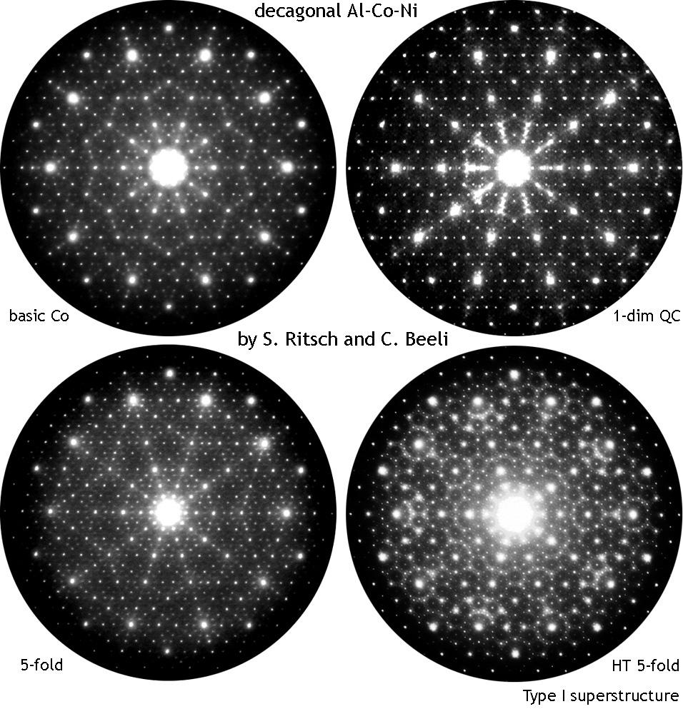
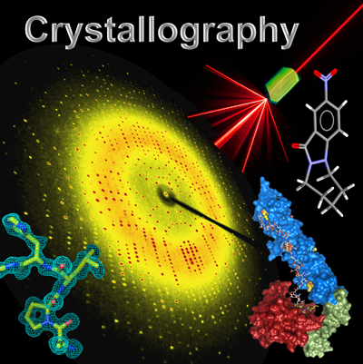
Electrons bend and have interference like waves do.

Slide 13
Electron: Both wave and particle

Slide 14
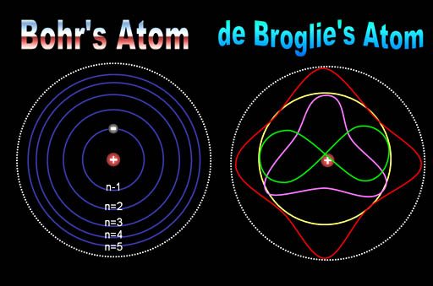
Electrons as particles that orbit the nucleus.
Electrons as waves that oscillate around the nucleus

Slide 15
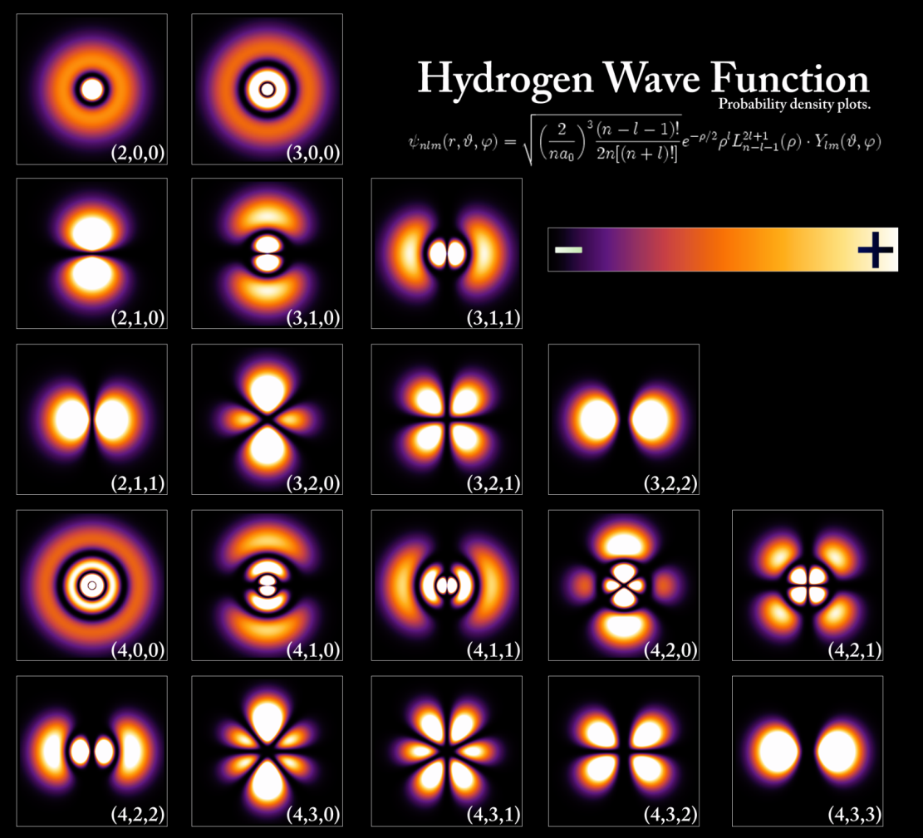
Various wave patterns that an electron can have.

Slide 16
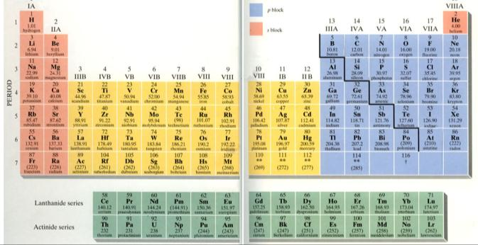
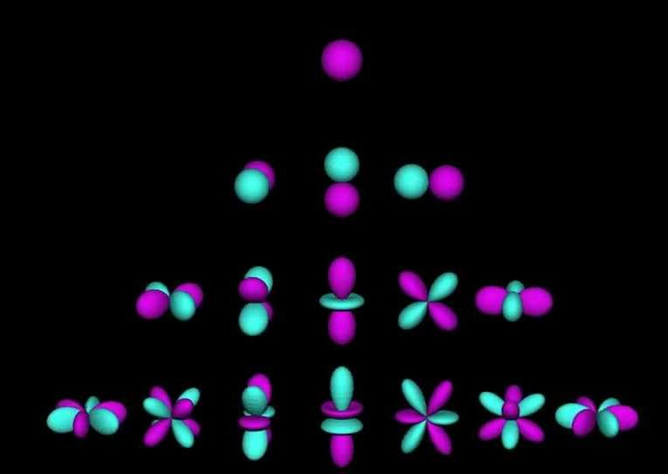

Slide 17
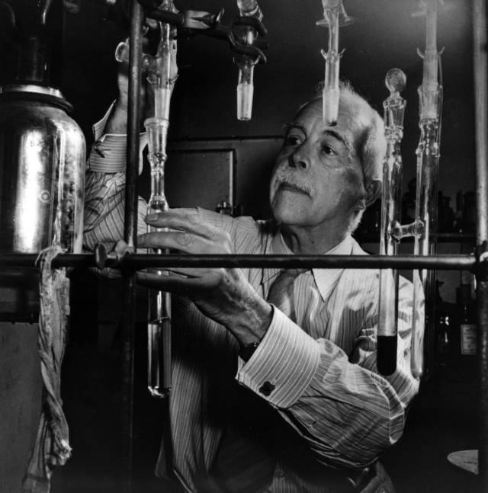
Gilbert Lewis invents a chemistry learning technique for keeping track of the outer electrons.

Slide 18
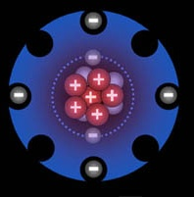
Lewis Dot Structure
Costello Hole-Punch Structure

Slide 19
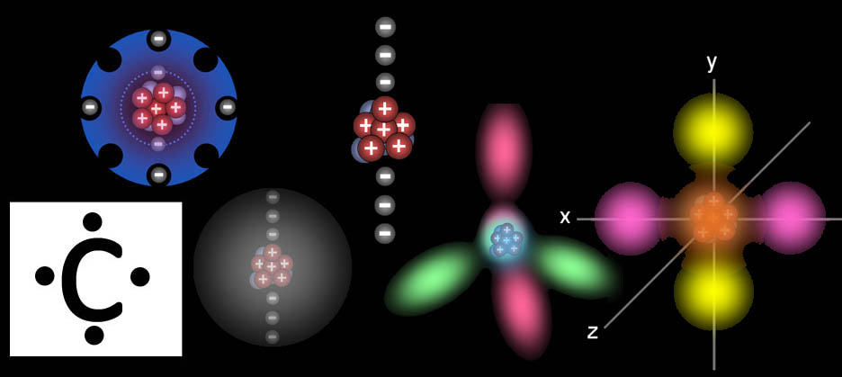
5 ways of showing a carbon atom
C

Slide 20
Why atoms bond

Slide 21
Why atoms bond
H
2
Atoms who bond by sharing have an electron to share and a vacancy to accept an electron.
COVALENT BONDING

Slide 23
Why atoms don’t bond
Helium
Hydrogen
If an atom has no vacancies (holes), then it won’t accept any more electrons nor will it given any away.

Slide 24
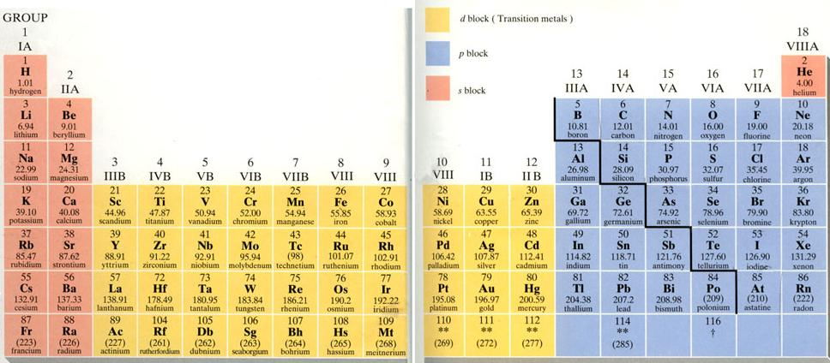
Lewis used dots to indicate the number of outer (valence) electrons around the atom of that element. He knew these dots would help students figure out how elements would combine.
Ne
S
H
Al
Cl
Li
N
Mg
F
O
C

Slide 25
Valence Electrons
These outer electrons are called valence electrons. (valens is Latin meaning to be strong. The word valiant also comes from valens). Valence electrons give the elements the strength to react with other elements. Valence electrons are given away, taken, or shared. This results in two elements combining (bonding) with each other.
O

Slide 26
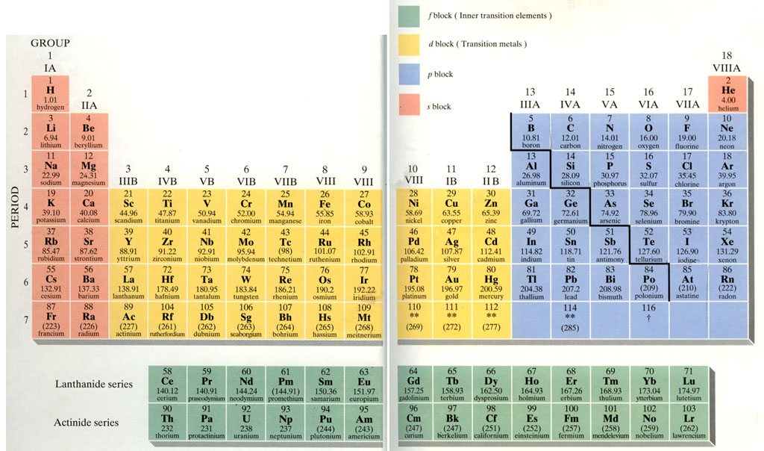
“Most GENEROUS"
NON-METALS
METALS
“Most GREEDY"

Slide 27
_
2+
_
H
I
H
I
H
I
Cl
Mg
Cl
Ne
_
S
+
H
Li
Cl
Cl
Al
Li
N
F
Mg
O
C

Slide 28
A metal gives electron(s) to a non-metal. The metal becomes positive and the non-metal becomes negative. They now attract each other.
+1
1
+2
+3
-4
-3
-2
-1
H | 2 |  |  |  |  |  |  |  |  |  |  | 13 | 14 | 15 | 16 | 17 | He
Li | Be |  |  |  |  |  |  |  |  |  |  | B | C | N | O | F | Ne
Na | Mg | 3 | 4 | 5 | 6 | 7 | 8 | 9 | 10 | 11 | 12 | Al | Si | P | S | Cl | Ar
K | Ca |  | Ti | V | Cr | Mn | Fe | Co | Ni | Cu | Zn | Ga | Ge | As | Se | Br | Kr
Rb |  |  | Zr |  |  |  |  |  |  | Ag |  |  |  |  |  | I | Xe
Cs | Ba |  |  |  | W |  |  |  | Pt | Au | Hg |  | Pb |  |  |  | Rn
Fr
 |  | U |  | Pu

Slide 29
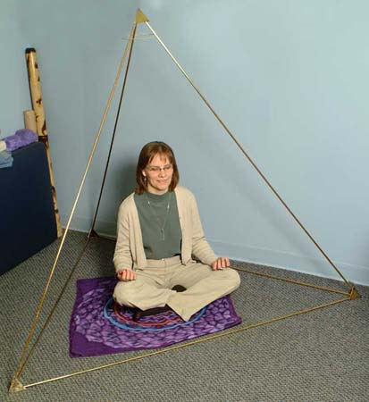
Ne
F
F
O
O
O
S
Why eight?

Slide 30
Methane building blocks
H
C
H
H
H
C
H
H
C
H
H
H

Slide 31
1s
2s
2p_{x}
2p_{y}
2p_{z}
sp³ sp³ sp³ sp³
y
Hybridize
Promote
3
sp
x
H
H
z
H
C
H
H
C
H
H
H
Don’t worry about the details of this electron behavior, just appreciate the amazing ability that electrons have in adjusting their angles and shapes to accommodate bonding to one or many atoms.
Methane: Carbon

Slide 32
Phosphorus Pentachloride
PCl₅
P
Cl
Cl
Cl
Cl
Cl
Cl
Cl
P
P
Cl
Cl
Cl
Cl

Slide 33
sp³d sp³d sp³d sp³d sp³d
Neon
2
3s
3p_{x}
3p_{y}
3p_{z}
d_{xz} d_{yz} d_{xy} d_{x}2_{-y}2 d_{z}2
90º
Hybridized
Promoted
3
120º
sp d
Trigonal Bipyramidal
120º
Again, don’t worry about the details of this electron behavior, just appreciate the amazing ability that electrons have in adjusting their angles and shapes to accommodate bonding different kinds of atoms and different numbers of atoms.
Phosphorus Pentachloride: Phosphorus

Slide 34
Cl
Cl
P
Cl
Cl
Cl

Slide 35
Here is another possible arrangement for phosphorus and chlorine. This time it shares just 3 of its electrons and accepts 3 electrons from the chlorine atoms.
Phosphorus Pentachloride
PCl₅
Cl
Cl
Cl
Cl
Cl
Cl
Cl
Cl
Cl
P
P
P
Cl
Cl
Cl
Cl
Cl
Cl
Cl
Cl
P
Cl
Phosphorus trichloride
PCl₃

Slide 36
Hydrogen Cyanide
HCN
π bond
C
N
Sigma bond
π bond
H
C
N
Don’t worry about the details of this bonding. Just realize that simple formulas like HCN don’t show the full story of how electrons pull hydrogen, carbon, and nitrogen together.

Slide 37
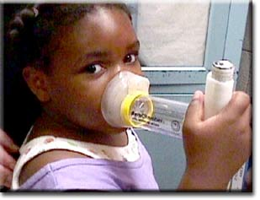
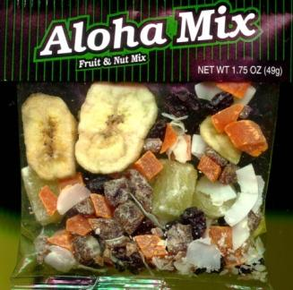
sulfite
-2
SO₂ turns to sulfurous acid when it contacts water.
O
S
-
O
-
O
(Sulfur dioxide SO₂) Used as a preservative in wine for its antibacterial properties.. Sulfur dioxide may be used to fumigate fruit and vegetables to extend their shelf life, but 1 in 100 people are allergic to it.
Occurs naturally in the atmosphere and as a pollutant from combustion of fuels that contain sulfur. Sulfur dioxide is one cause of acid rain.
Wine & trail mix labels list SO₂ as an ingredient rather than saying sulfurous acid.

Slide 38
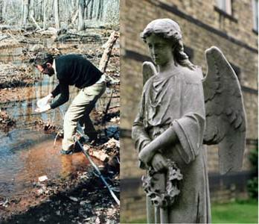
SULFITE

Slide 39
sulfite
-2
O
O
O
S
S
S
O
S
O
SO SO₂ SO₃ SO₃⁻²
O
O
O
O
(Sulfite) Used to sterilize fermentation equipment and food containers, as well as for its antimicrobial properties. Generally meat, cereals and dairy products may not be treated with it as it destroys thiamine (vitamin B1) content. Over exposure to sulfites in food may cause an asthmatic attack.
1 out 100 people are sensitive to sulfite causing allergic reactions. Some people have died.

Slide 40
sulfite
-2
sulfate
-2
O
O
O
O
S
O
S
S
O
S
O
S
O
O
O
O
O
O
Sulfite
Sulfate
Sulfur trioxide
Sulfur monoxide
Sulfur dioxide

Slide 41
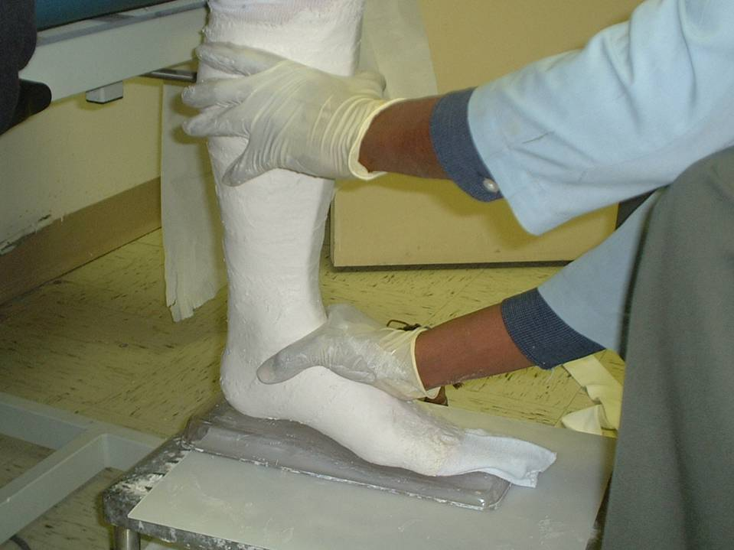
Calcium Sulfate hemi-hydrate
CaSO₄ • ½ H₂O

Slide 42
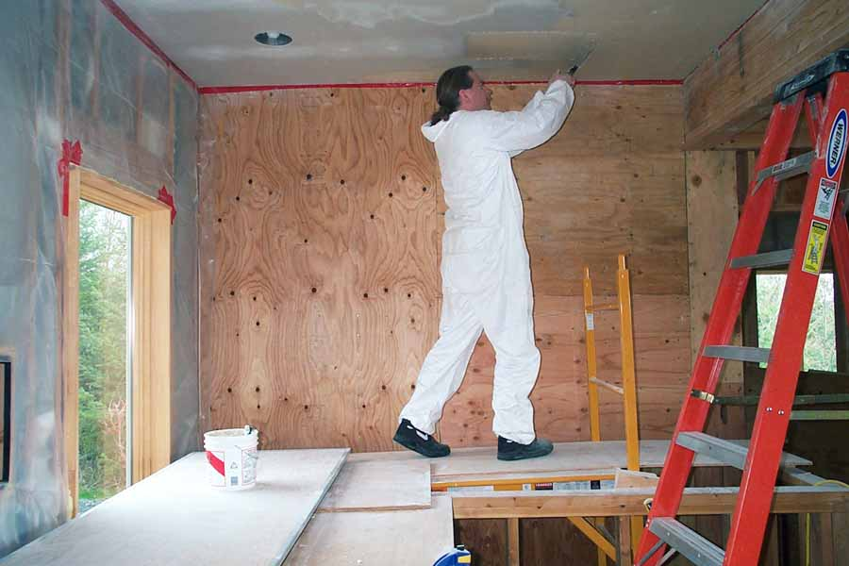
Calcium Sulfate dihydrate
CaSO₄ • 2H₂O

Slide 43
White Sands, NM
CaSO₄ • 2H₂O

Slide 44
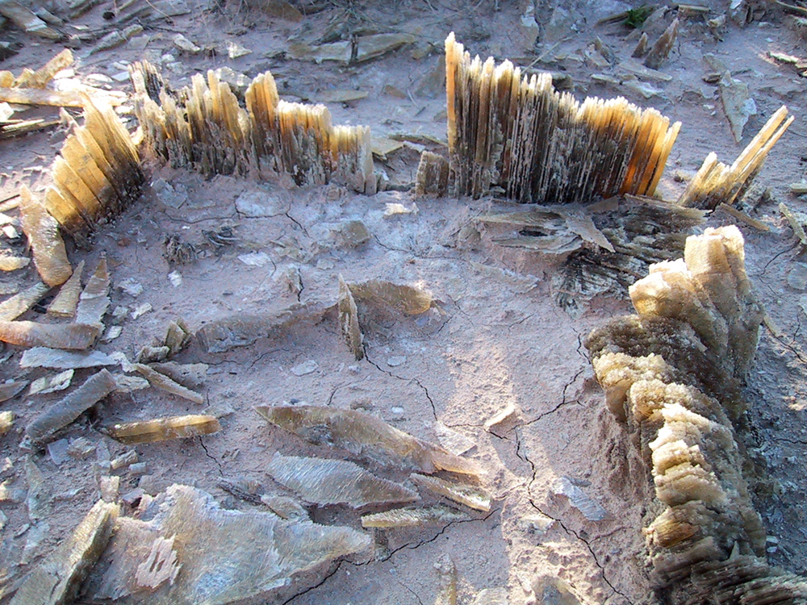
White Sands, NM
CaSO₄ • 2 H₂O

Slide 45
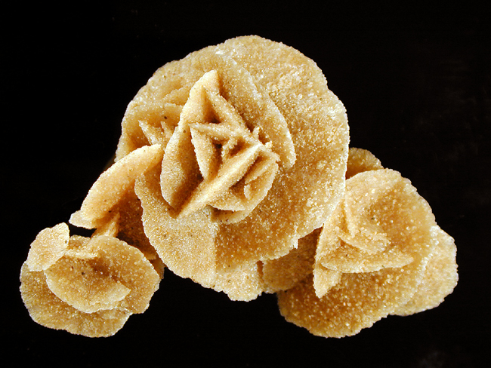
Desert Rose

Slide 46
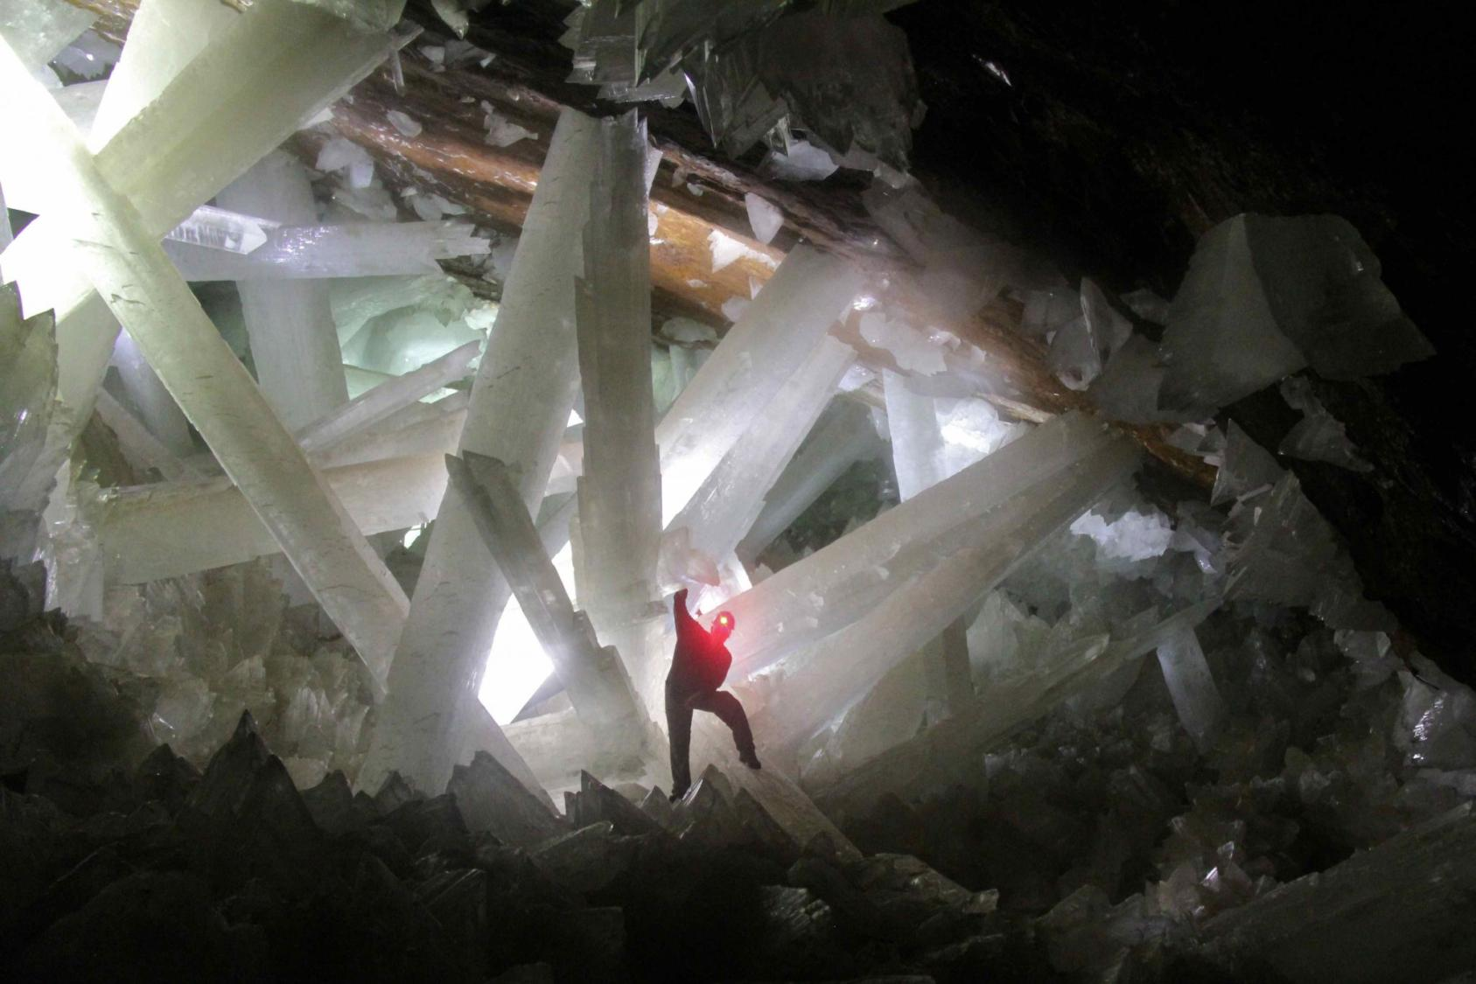
Crystal Cave in Naica, Mexico
CaSO₄•2H₂O

Slide 47
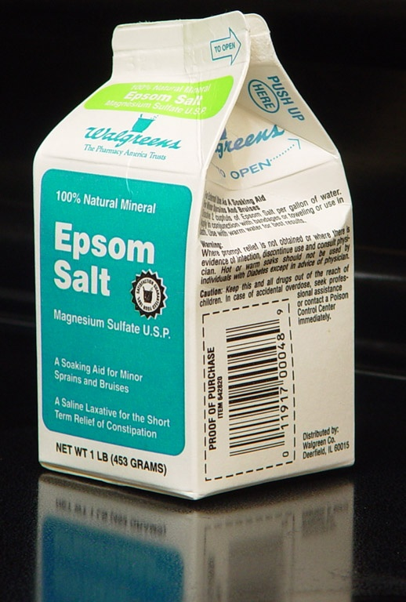
Epsom Salts [MgSO₄ • 7H₂0]

Slide 48
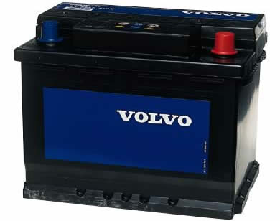
H₂SO₄
Sulfuric acid (battery acid)
2H⁺ + SO₄⁻²

Slide 49
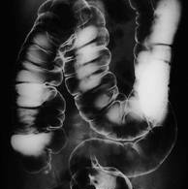
Barium Sulfate (BaSO₄) (contrast medium for xrays)

Slide 50
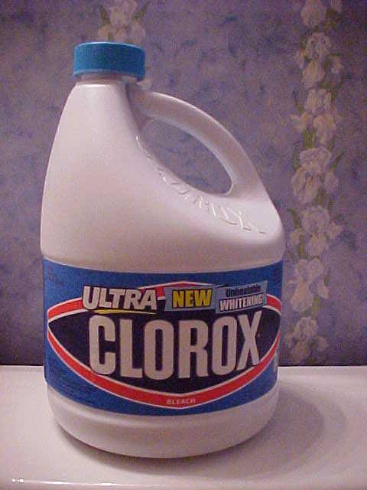
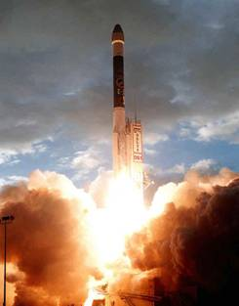
CHLORATES

Slide 51
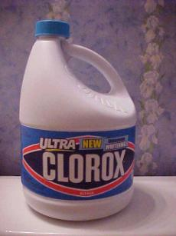
chlorite
chlorate
perchlorate
Sodium
O
O
O
hypochlorite
Cl
Cl
Cl
Cl
O
O
Cl
O
Cl
O
O
O
O
Cl₂ ClO⁻ ClO₂⁻ ClO₃⁻ ClO₄⁻
Chlorate & perchlorate strong oxidizers
When heated, metallic chlorates & perchlorates turn into salt plus oxygen. 2KClO₃ → 2KCl + 3O₂
Fireworks, explosives, O₂ for rocket fuel

Slide 52
These negative ions will ionic bond with any positive ion such as metal ions.
Sodium
hypochlorite
O
Cl
+
Na
+
K
O
Cl
O
O
NaClO
Sodium hypochlorite
O
KClO₄
Potassium perchlorate

Slide 53
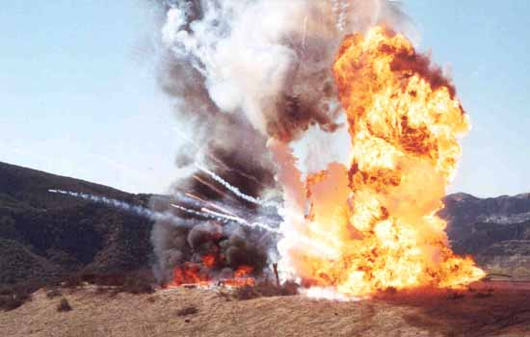
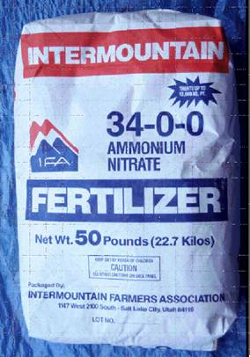
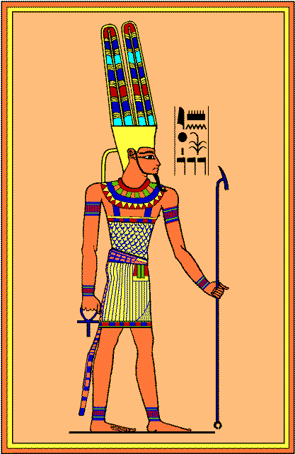
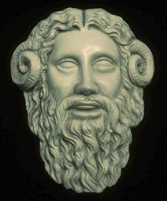
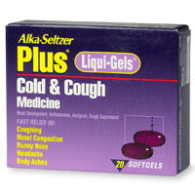
AMMONIUM

Slide 54
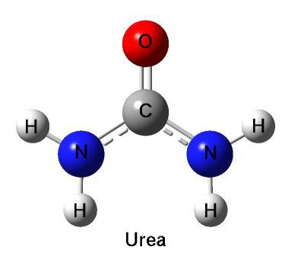
AMMONIA
-
N
-
-
Ammonia is created in the body from digestion of proteins and amino acids. If there’s an excess of nitrogen, the body converts it to urea, which is less toxic. Urea is expelled in the urine.
Some babies are born without the enzymes to convert ammonia to urea, so they develop hyperammonemia, which is fatal or will cause brain damage.
Ammonia is formed when animal waste is decomposed by bacteria.

Slide 55
AMMONIA +PROTON = Ammonium
+1
-1
-
N
O
-
-
-
-
Ammonia added to water will form ammonium hydroxide (cleaning “ammonia”)
Ammonium nitrate: Fertilizer, explosives Ammonium chloride: conducts electricity inside dry-cell batteries. Also used in cough medicines to hide the taste of bitter tasting medicines. Also used as expectorant.

Slide 56
The positive ammonium ion forms an ionic bond with any negative ion.
+1
-1
-
N
Cl
-
-
(NH₄)₂SO₄
Ammonium sulfate
NH₄Cl
Ammonium chloride
2-
+1
+1
O
-
-
N
O
S
O
N
-
-
-
-
O

Slide 57
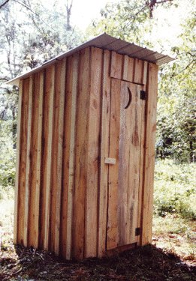
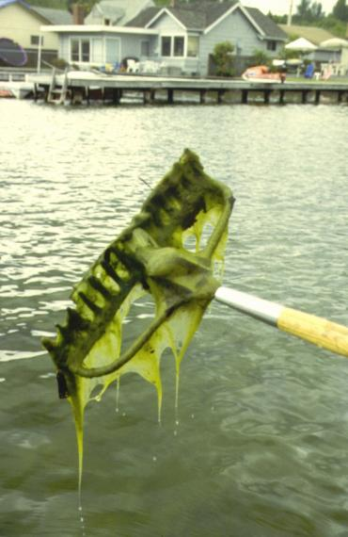
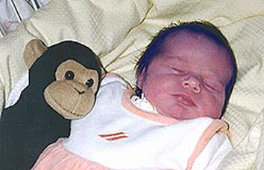
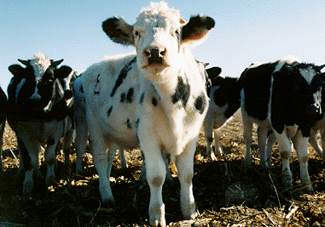
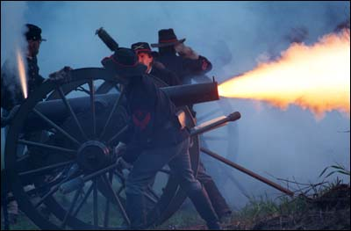
NITRATES/NITRITES

Slide 58
Nitrate
Nitrite
-1
-1
O
N
N
O
N
O
N
O
O
NO₂⁻
NO₃⁻

Slide 59
High nitrate levels in drinking water can harm infants. Nitrate is converted into nitrite by bacteria that survives in infants’ stomachs.
by bacteria that survives in infants’ stomachs causing “blue baby syndrome”
The nitrite in the blood converts the hemoglobin in red blood cells to methemoglobin (“meta” + hemoglobin)
The altered hemoglobin reduces the ability of the blood to carry oxygen, causing a condition known as methemoglobinemia, or "blue baby syndrome” because the baby turns blue due to lack of oxygen.

Slide 60
Na
Cl
[
]
[
]
_
-
+
Na
Cl
+

Slide 61
A sodium ion (Na⁺) will not bond with a chlorine atom. Na⁺ outer orbit is full and stable.
+
+
Cl
Na
[
]
[
]
Likewise, a sodium metal atom will not bond with the chloride ion (Cl⁻).
-
-
Na
Cl

Slide 62
Na
Na
Cl
2

Slide 63
+
+
Na
Na
_
Cl
Cl
_

Slide 64
+
_
Na
Cl
Na
+
Cl
_

Slide 65
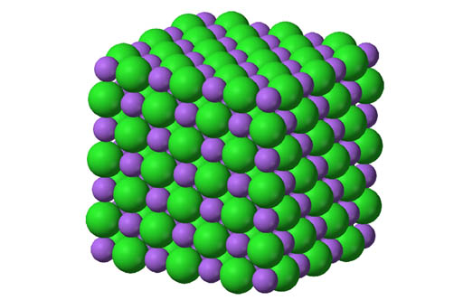
NaCl (Sodium chloride)

Slide 66
H
2
O
2

Slide 67
H
H
O

Slide 69
C
F
F
F
F
F
C
F
F
C
F
F
F

Slide 70
Fluorine
F
F

Slide 71
Carbon

Slide 72
Organic compounds are compounds that usually come from organisms. They always have carbon and often have other elements like hydrogen, oxygen, and nitrogen.
Examples: Alcohol, Sugar, Fat, Protein

Slide 73
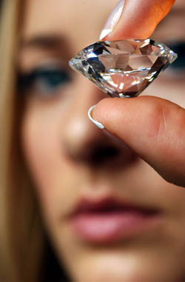
Diversity within Same Element

Slide 74
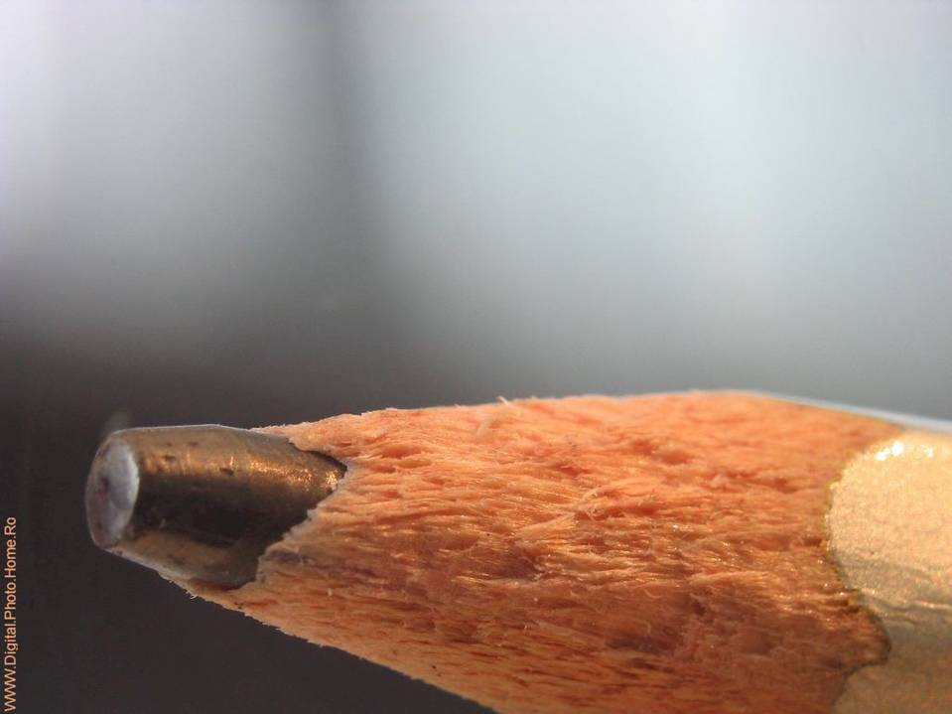
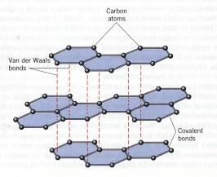
Diversity within Same Element
Carbon as Graphite

Slide 75
Diversity within Same Element
Amorphous Carbon. Lampblack
Used in black inks in paints, copiers, ink-jet printers.

Slide 76
Carbon connected as spheres

Slide 77
CARBON NANOTUBES

Slide 78
COMPOUNDS
Hydrogen
Compounds are two or more elements that share electrons (covalent bonds) or have taken or given electrons away (ionic bonds).
Carbon
Hydrogen
Hydrogen
Hydrogen

Slide 79
COMPOUNDS
Hydrogen
Compounds are two or more elements that share electrons.
Carbon-6
Hydrogen
Hydrogen
Hydrogen

Slide 80
IONIC BONDING
12 (+) 10 (-) +2 Charge
Magnesium 12 protons 10 electrons
Oxygen 8 protons 10 electrons
8 (+) 10 (-) -2 Charge
8 outer electrons
8 outer electrons

Slide 81
Elements are the new building blocks
C
O
C
N
H
H
H
H
C
O
H
H
H

Slide 82
3 kinds of graphic elements build a brick
Brick becomes building block for a layer of bricks
Layer of bricks becomes building block for wall of bricks

Slide 84
INORGANIC

Slide 85
Quartz
Silicon dioxide
Si
Silicon is in the same group (column) as carbon, so it also has 4 outer electrons. This allows it to connect to two oxygen atoms to form SiO2, or it can connect to 4 oxygen atoms when it is stacked with other silicon and oxygen atoms as shown. (Silver balls are silicon).

Slide 86
(Weight) Oxygen 50% & Silicon 30%
Main building blocks of minerals
The other common elements in order of abundance are the metals aluminum, iron, calcium, sodium, and potassium.
Minerals usually contain metal ion ionically bonded to a group of non-metals that are covalently bonded to other non-metals. Example: Emerald. Be₂Al₂(SiO₃)₆. Be (beryllium) ions are +2 each. Al (aluminum) ions are +3 each. They have an ionic bond with six SiO₃ (silicate) ions. The SiO₃ ions are -2 each. Silicon and oxygen are covalently bonded.

